Slide 1
CLEAN DEVELOPMENT MECHANISM

Slide 2
What is it?
One of the flexibility mechanism identified in Kyoto Protocol that can be used to meet GHG (Green House Gas ) reduction targets.
It is the only mechanism that includes developing countries.

Slide 3
Article 12 of the Kyoto Protocol allows developed countries and countries with economies in transition to meet their greenhouse gas reduction commitments by engaging in CDM projects that reduce GHG emissions. Developing, or non-Annex I, countries that have ratified the Kyoto Protocol can benefit from these CDM projects to promote sustainable development. Annex I countries, in return, receive certified emission reduction (CERs) credits for investing in CDM projects in non-Annex I countries, which can be used against their GHG reduction commitments under the Kyoto Protocol.

Slide 4
objectives
Help and slow climate change
Guide developing nations to develop sustainable methods
Assist developed countries to reduce their emission and move towards cheaper forms of energy
Help countries to find and innovate new methods to reduce emission

Slide 5
Types of CDM projects
Reducing dependancy of fossil fuels
Using animal waste to generate energy and manage it efficiently
Fuel and electricity efficient household and offices
Reducing the emission involved in manufacturing process

Slide 6
Small scale CDM projects
Type I: RE projects with a maximum output capacity equivalent to up to 15 megawatts (or an appropriate equivalent)
Type II: energy-efficiency improvement project activities which reduce energy consumption on the supply and/or demand side by up to the equivalent of 15 gigawatt-hours per year
Type III: other project activities that both reduce anthropogenic emissions by sources and directly emit less than 15 kilotonnesof CO2 equivalent (CO2e) annually

Slide 7
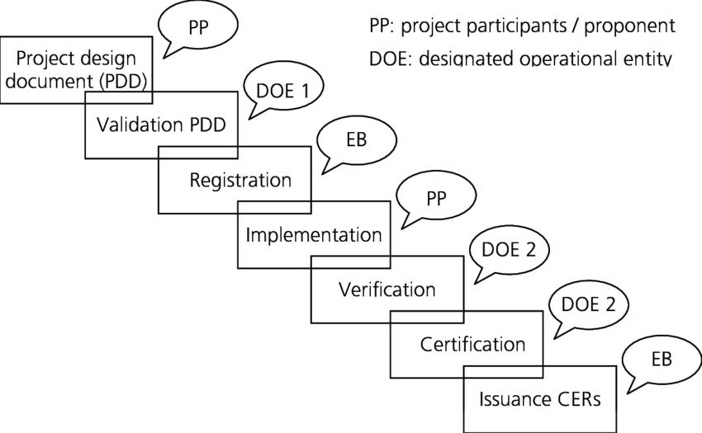
Steps in CDM project cycle:

Slide 8
Steps for implementing CDM project
Project identification
Identify idea having potential to reduce emission
Government Endorsement
Presented before respective ministry. ie ministry of energy water resources and irrigation.
Project Development
Study is carried out to measure baseline according to which emission change will be measured as per Kyoto protocol

Slide 9
Validation
Result of baseline identification survey is verified by CDM executive body
Registration
Formal acceptance provide a project legal and financial support.
Monitoring
Changes in greenhouse gases emission is monitored from time to time and amendments are made.

Slide 10
Verification
Verified by team of professionals.
Certification
After completion the body certifies project have successfully reduced emission per plan

Slide 11
CDM opportunities in Nepal
Renewable Energy
Micro hydro power generation
Solar energy -power, heating, lighting
Biomass based energy -power, heating
Wind based power generation
Geo-thermal energy utilization -heating/ cooling, power generation
Energy Efficiency
Process optimization: new technology, retrofits
Building Energy Efficiency
Power Generation
Efficiency Improvement in T&D
Energy Efficient Lighting technology

Slide 12
Thank you

